Slide 1
Lec.1 Introduction of Programming Paradigms
Instructor : Prashant Mishra

Slide 2
Paradigm can also be termed as method to solve some problem or do some task. Programming paradigm is an approach to solve problem using some programming language or also we can say it is a method to solve a problem using tools and techniques that are available to us following some approach.
There are lots for programming language that are known but all of them need to follow some strategy when they are implemented and this methodology/strategy is paradigms. Apart from varieties of programming language there are lots of paradigms to fulfill each and every demand.

Slide 3
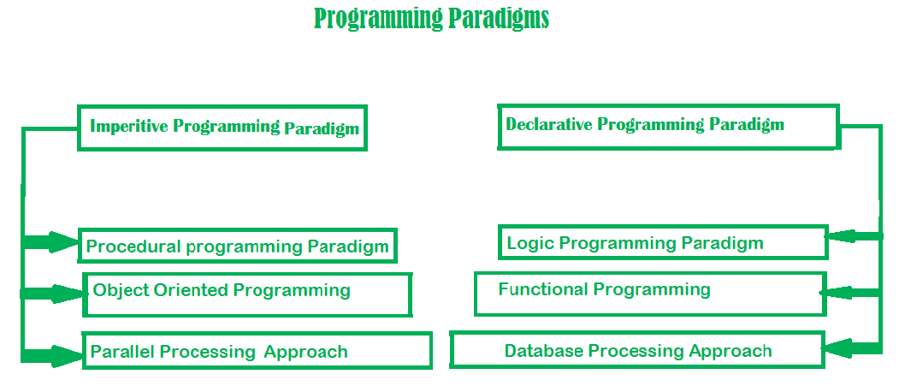

Slide 4
Imperative programming paradigm
It is one of the oldest programming paradigm. It features close relation to machine architecture. It is based on Von Neumann architecture. It works by changing the program state through assignment statements. It performs step by step task by changing state. The main focus is on how to achieve the goal. The paradigm consist of several statements and after execution of all the result is stored.
Imperative programming is a programming paradigm that uses statements that change a program’s state.

Slide 5
The 'first do this, next do that' is a short phrase which really in a nutshell describes the spirit of the imperative paradigm. The basic idea is the command, which has a measurable effect on the program state. The phrase also reflects that the order to the commands is important. 'First do that, then do this' would be different from 'first do this, then do that'.

Slide 6
Imperative programming is paradigm of computer programming in which the program describes a sequence of steps that change the state of the computer. Unlike declarative programming, which describes "what" a program should accomplish, imperative programming explicitly tells the computer "how" to accomplish it. Programs written this way often compile to binary executables that run more efficiently since all CPU instructions are themselves imperative statements.

Slide 7
To make programs simpler for a human to read and write, imperative statements can be grouped into sections known as code blocks. In the 1950s, the idea of grouping a program's code into blocks was first implemented in the ALGOL programming language. They were originally called "compound statements," but today these blocks of code are known as procedures. Once a procedure is defined, it can be used as a single imperative statement, abstracting the control flow of a program and allowing the developer to express programming ideas more naturally. This type of imperative programming is called procedural programming, and it is a step towards higher-level abstractions such as declarative programming.

Slide 8
In the itemized list below we describe the main properties of the imperative paradigm
· Characteristics:
· Discipline and idea
· Digital hardware technology and the ideas of Von Neumann
· Incremental change of the program state as a function of time.
· Execution of computational steps in an order governed by control structures
· We call the steps for commands
· Straightforward abstractions of the way a traditional Von Neumann computer
works
· Similar to descriptions of everyday routines, such as food recipes and car repair
· Typical commands offered by imperative languages
· Assignment, IO, procedure calls
· Language representatives
· Fortran, Algol, Pascal, Basic, C
· The natural abstraction is the procedure
· Abstracts one or more actions to a procedure, which can be called as a
single command.
· "Procedural programming"

Slide 9
Advantage:
Very simple to implement
It contains loops, variables etc.
Disadvantage:
Complex problem cannot be solved
Less efficient and less productive
Parallel programming is not possible

Slide 10
Examples of Imperative programming paradigm:
C : developed by Dennis Ritchie and Ken Thompson
Fortan : developed by John Backus for IBM
Basic : developed by John G Kemeny and Thomas E Kurtz

Slide 11
Imperative programming is divided into three broad categories:
Procedural
OOP
parallel processing.

Slide 12
Procedural programming paradigm – This paradigm emphasizes on procedure in terms of under lying machine model. There is no difference in between procedural and imperative approach. It has the ability to reuse the code and it was boon at that time when it was in use because of its reusability.
Examples of Procedural programming paradigm:
C : developed by Dennis Ritchie and Ken Thompson
C++ : developed by Bjarne Stroustrup
Java : developed by James Gosling at Sun Microsystems
ColdFusion : developed by J J Allaire
Pascal : developed by Niklaus Wirth

Slide 13
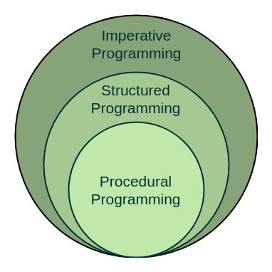

Slide 14
Object oriented programming – The program is written as a collection of classes and object which are meant for communication. The smallest and basic entity is object and all kind of computation is performed on the objects only. More emphasis is on data rather procedure. It can handle almost all kind of real life problems which are today in scenario.
Advantages:
Data security
Inheritance
Code reusability
Flexible and abstraction is also present

Slide 15
Examples of Object Oriented programming paradigm
Simula : first OOP language
Java : developed by James Gosling at Sun Microsystems
C++ : developed by Bjarne Stroustrup
Objective-C : designed by Brad Cox
Visual Basic .NET : developed by Microsoft
Python : developed by Guido van Rossum
Ruby : developed by Yukihiro Matsumoto
Smalltalk : developed by Alan Kay, Dan Ingalls, Adele Goldberg

Slide 16
Parallel processing approach –
Parallel processing is the processing of program instructions by dividing them among multiple processors. A parallel processing system posses many numbers of processor with the objective of running a program in less time by dividing them. This approach seems to be like divide and conquer. Examples are NESL (one of the oldest one) and C/C++ also supports because of some library function.

Slide 17
Structured Programming Approach, as the word suggests, can be defined as a programming approach in which the program is made as a single structure. It means that the code will execute the instruction by instruction one after the other. It doesn’t support the possibility of jumping from one instruction to some other with help of any statement like GOTO, etc. Therefore, the instructions in this approach will be executed in a serial and structured manner. The languages that support Structured programming approach are:
C
C++
Java
C#
..etc

Slide 18
The structured program mainly consists of three types of elements:
Selection Statements
Sequence Statements
Iteration Statements
The structured program consists of well structured and separated modules. But the entry and exit in a Structured program is a single-time event. It means that the program uses single-entry and single-exit elements. Therefore a structured program is well maintained, neat and clean program. This is the reason why the Structured Programming Approach is well accepted in the programming world.

Slide 19
Advantages of Structured Programming Approach:
Easier to read and understand
User Friendly
Easier to Maintain
Mainly problem based instead of being machine based
Development is easier as it requires less effort and time
Easier to Debug
Machine-Independent, mostly.
Disadvantages of Structured Programming Approach:
Since it is Machine-Independent, So it takes time to convert into machine code.
The converted machine code is not the same as for assembly language.
The program depends upon changeable factors like data-types. Therefore it needs to be updated with the need on the go.
Usually the development in this approach takes longer time as it is language dependent. Whereas in the case of assembly language, the development takes lesser time as it is fixed for the machine.

Slide 20
Declarative programming
Declarative programming is a computer programming paradigm that the developer defines what the program should accomplish rather than explicitly defining how it should go about doing so. This approach lends itself naturally to the programmatic definition of formal logic systems, and has the benefit of simplifying the programming of some parallel processing applications.
Declarative programming is a programming paradigm that expresses the logic of a computation without describing its control flow.

Slide 21
It is divided as Logic, Functional, Database. In computer science the declarative programming is a style of building programs that expresses logic of computation without talking about its control flow. It often considers programs as theories of some logic . It may simplify writing parallel programs. The focus is on what needs to be done rather how it should be done basically emphasize on what code code is actually doing. It just declare the result we want rather how it has be produced. This is the only difference between imperative (how to do) and declarative (what to do) programming paradigms. Getting into deeper we would see logic, functional and database.

Slide 22
Logic programming paradigms
It can be termed as abstract model of computation. It would solve logical problems like puzzles, series etc. In logic programming we have a knowledge base which we know before and along with the question and knowledge base which is given to machine, it produces result. In normal programming languages, such concept of knowledge base is not available but while using the concept of artificial intelligence, machine learning we have some models like Perception model which is using the same mechanism. In logical programming the main emphasize is on knowledge base and the problem. The execution of the program is very much like proof of mathematical statement, e.g., Prolog

Slide 23
Functional programming paradigms
The functional programming paradigms has its roots in mathematics and it is language independent. The key principal of this paradigms is the execution of series of mathematical functions. The central model for the abstraction is the function which are meant for some specific computation and not the data structure. Data are loosely coupled to functions . The function hide their implementation. Function can be replaced with their values without changing the meaning of the program. Some of the languages like perl, java script mostly uses this paradigm

Slide 24
Functional programming is a programming paradigm in which we try to bind everything in pure mathematical functions style. It is a declarative type of programming style. Its main focus is on “what to solve” in contrast to an imperative style where the main focus is “how to solve”. It uses expressions instead of statements. An expression is evaluated to produce a value whereas a statement is executed to assign variables.

Slide 25
Database/Data driven programming approach
This programming methodology is based on data and its movement. Program statements are defined by data rather than hard-coding a series of steps. A database program is the heart of a business information system and provides file creation, data entry, update, query and reporting functions. There are several programming languages that are developed mostly for database application. For example SQL. It is applied to streams of structured data, for filtering, transforming, aggregating (such as computing statistics), or calling other programs. So it has its own wide application.

Slide 26
Thank You

